Slide 1
What is the secret to being happy? Learning from the happiest countries in the world.
Sai Dheeraj Kanaparthi

Slide 2
How do the Nordic countries do it?
Since last few years, Nordic countries, namely, Norway, Finland, Iceland, Denmark, and Sweden have been at the top in terms of happiness. How have they maintained these ranks, and what do they do differently, that we in the United States don’t?
We start by looking at Maslow’s Hierarchy of Needs, which outlines the basic needs of every human, and essentially build up to happiness.

Slide 3
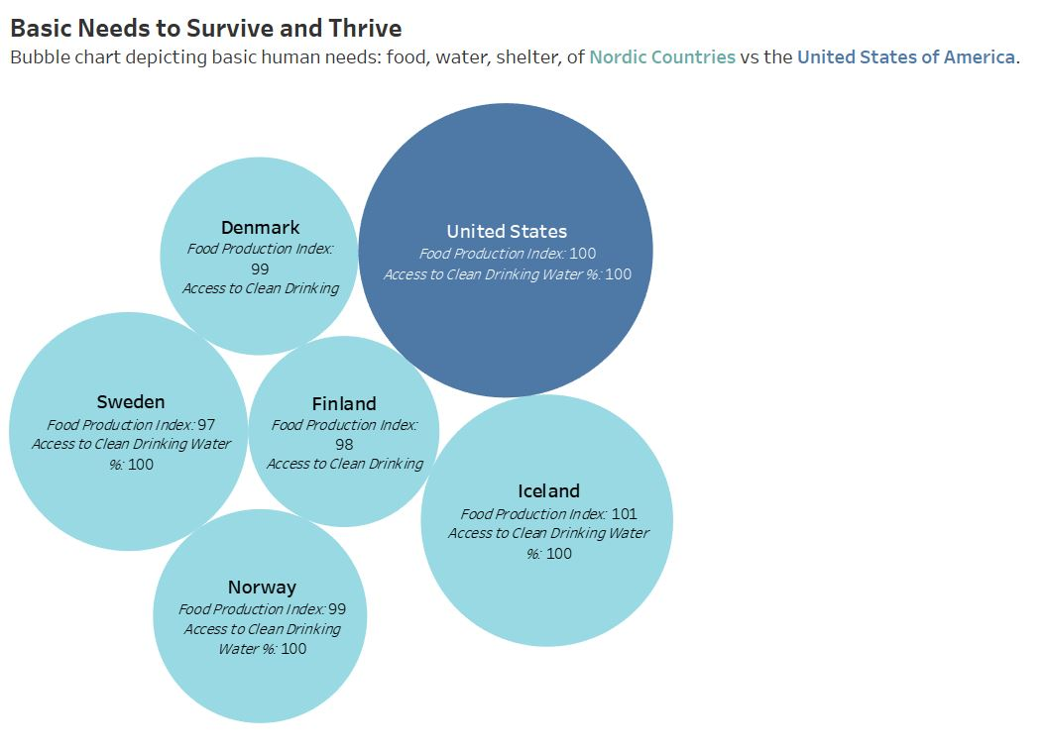
Physiological needs
The first level of Maslow’s Hierarchy of needs, is the Physiological needs.
These relate to food, water, shelter, clothing, air, clothing and reproduction.
The Nordic Countries and the United States excel at all these, leaving no stone unturned.
We represent those with households with the size of the bubble, with food produced and access to clean drinking water.

Slide 4
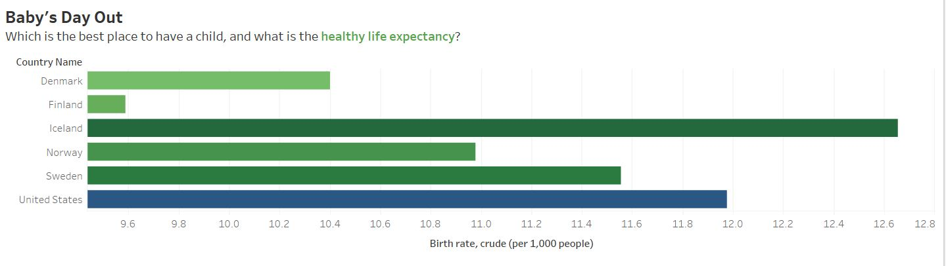
Physiological needs continued
Now that we have the most core basic needs covered, it is our human tendency to share a life together. This can be done in a multitude of ways, the most common one being having a baby.
We want to be in this world as long as possible and cherish the moments with our loved ones. The visualization below embellishes just that.
Why does the United States have a lower healthy life expectancy? According to the National Library of Medicine, few explanations could be differences in healthcare, individual behaviors, and possibly social policies.

Slide 5
What do the Nordic countries do differently?
The Nordic diet is one of the healthiest diets.
A robust health care system funded by the public, with crystal clear transparency.

Slide 6
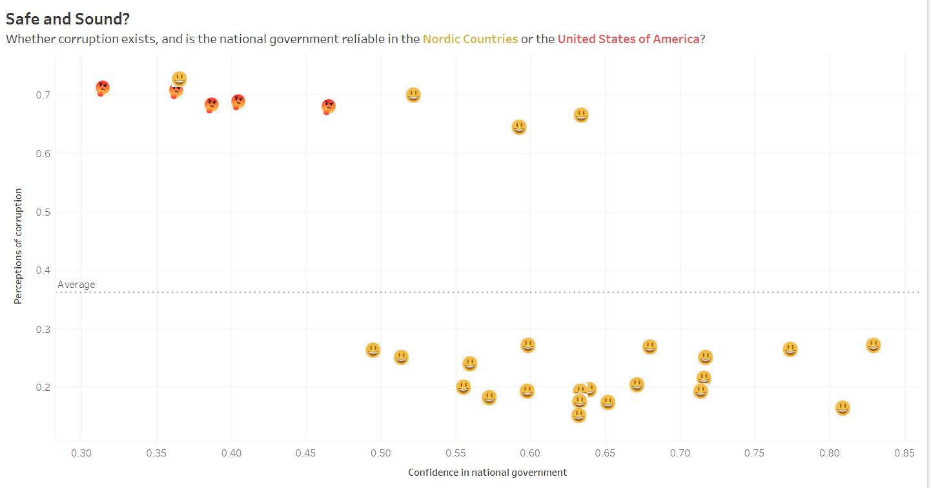
Safety Needs
Next in line, is how safe a place to live. We don’t want ourselves or our family to live in a place that isn’t favorable.
We’d like to live in place, where we’re protected by law and order, and where there is no wrongdoing happening by people or law makers themselves.
We look at corruption and the confidence in national government from 2017 to 2021. Looks like the people of United States find a lack of confidence in their government and presence of corruption.

Slide 7
What do the Nordic Countries do differently?
The ability to select to participate in selecting the government, freedom of expression, association and political stability.
The delivery quality of government is assessed by the people. This is about the exercise of power, control of corruption, government effectiveness.

Slide 8
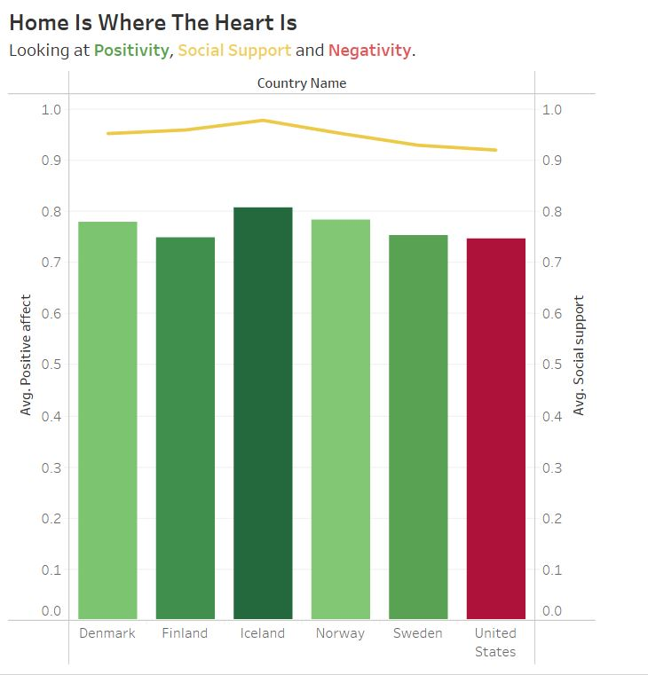
Love and belonging needs
Let’s say you immigrate to a new country. Wouldn’t you love to have a home away from home?
Of course, there’s no other country that can beat one’s home country. But a place where you feel loved and you feel like you belong, is a place worth going to, once in a lifetime.
Looking at the visualization, we see that the United States has a high amount of negativity compared to the positivity.

Slide 9
What do the Nordic countries do differently?
High levels of Social Trust.
Having a focus on the common good.

Slide 10
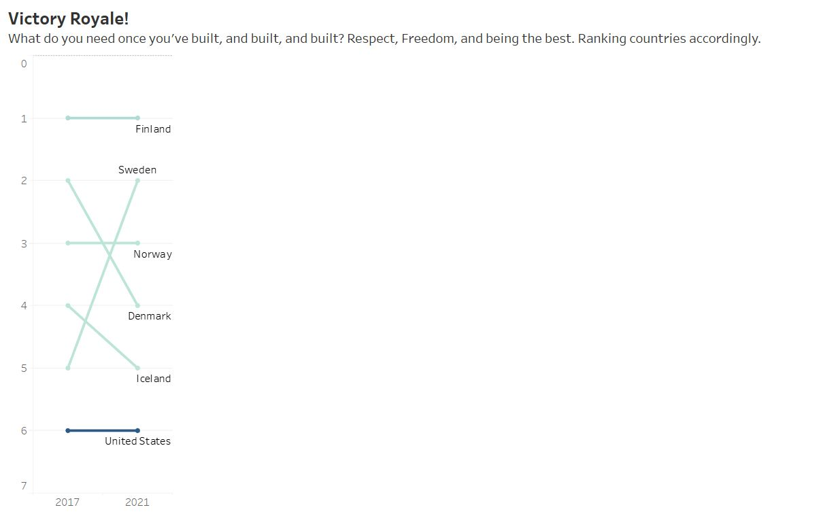
Esteem and Self-Actualization Needs
Finally, we come to the last need, the key to happiness, namely esteem and self-actualization needs.
Esteem needs relate to respect, status, recognition and freedom.
Self-actualization needs relate to the desire of being the most one can be.
Looking at the past 5 years, we see that Nordic countries have changed their ranks among themselves, but the United States has remained at the same rank.

Slide 11
What do the Nordic countries do differently?
Sense of agency and freedom.
Autonomy, and political and personal stability.

Slide 12
What are the secrets to being happy?
Robust Government and Healthcare, made by and for the people.
Freedom to make life choices and autonomy.
Healthy diet, less strenuous work hours with ample time for vacation.
High levels of trust among each other and a lookout for the common good.
Transparency and care for the people from the government.

Slide 13
Thank you!

Slide 14
Bibliography
https://www.ncbi.nlm.nih.gov/pmc/articles/PMC4112220/
https://www.healthline.com/nutrition/the-nordic-diet-review
https://www.euronews.com/next/2023/03/23/why-do-people-in-nordic-countries-consistently-rank-as-the-happiest-and-what-can-we-learn-
https://worldhappiness.report/ed/2020/the-nordic-exceptionalism-what-explains-why-the-nordic-countries-are-constantly-among-the-happiest-in-the-world/

